Slide 1
Regularization

Slide 2
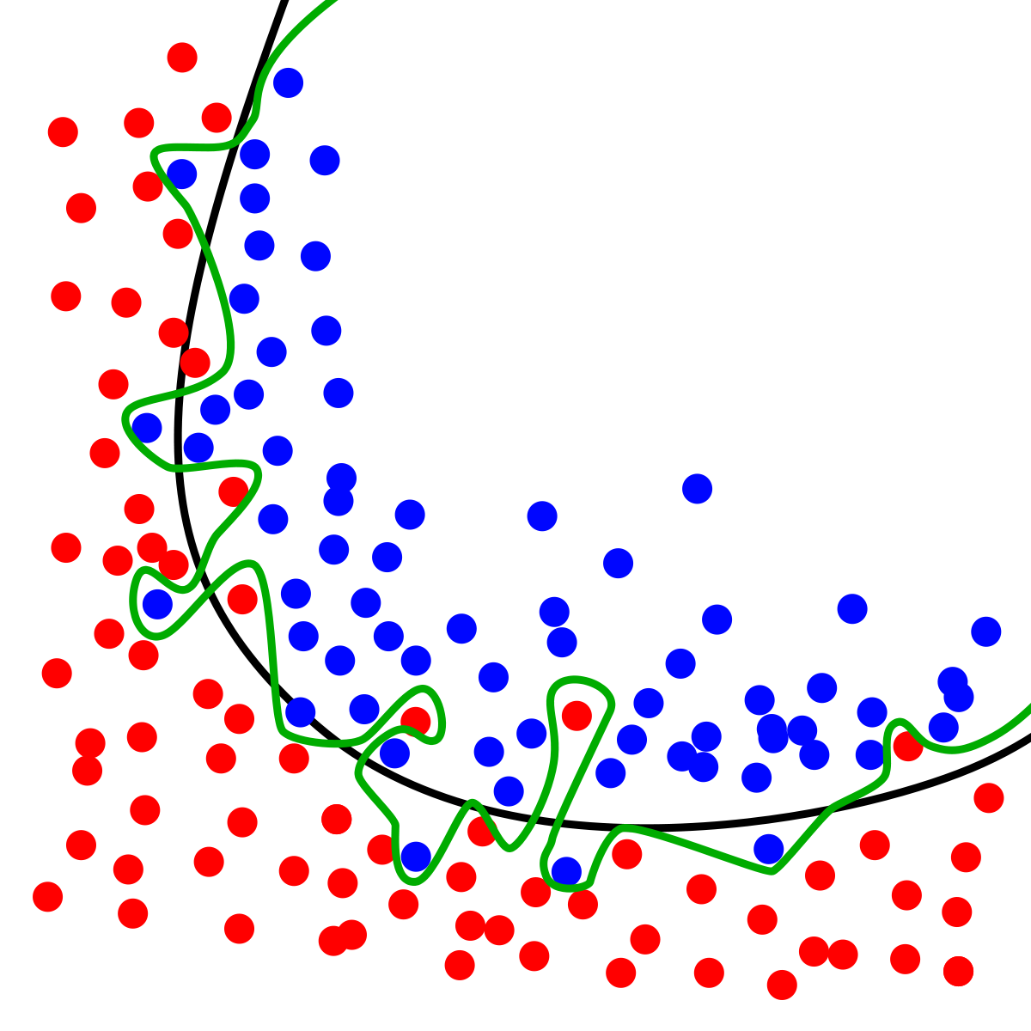
Regularization
Main goal: Avoid overfitting
Problems with overfitting?
Low Accuracy model
Not good at predicting
It likely give a misleding representation
of the data
One method is Cross-validation
This helps to balance bias vs variance

Slide 3
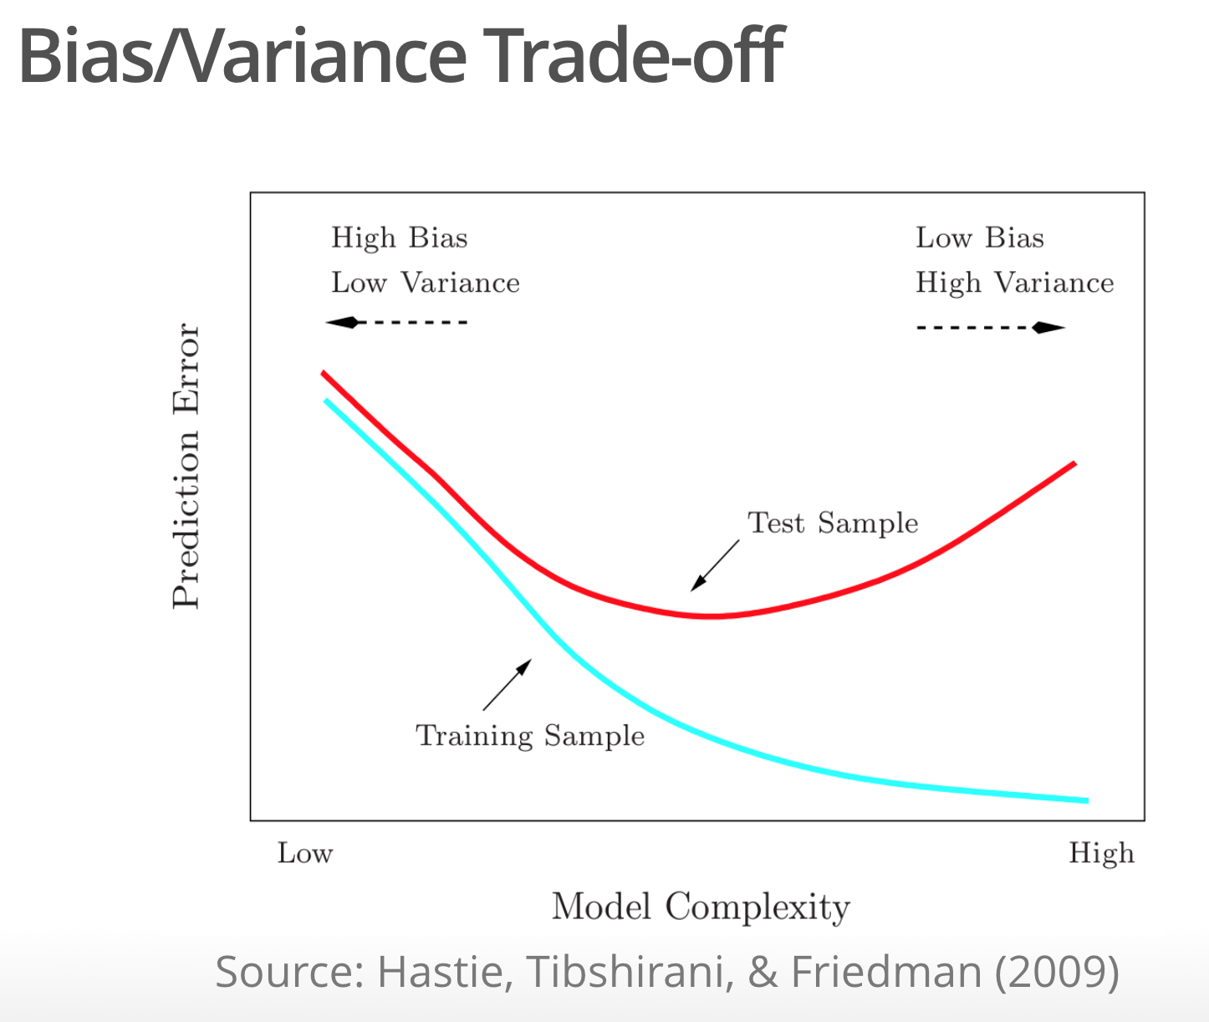
Regularization
Shrinks coefficients toward zero –
It attempts to reduce the model to one that maximizes the likelihood of the model.
It tends to decrease the variance even at the expense of increase the bias (the model fits a little less than without regularization)

Slide 4
Regularization
In practice we attempt to minimize the error that comes from the noise in the data.
In linear regression remember we are using
RSS (Residual sum of squares)

Slide 5
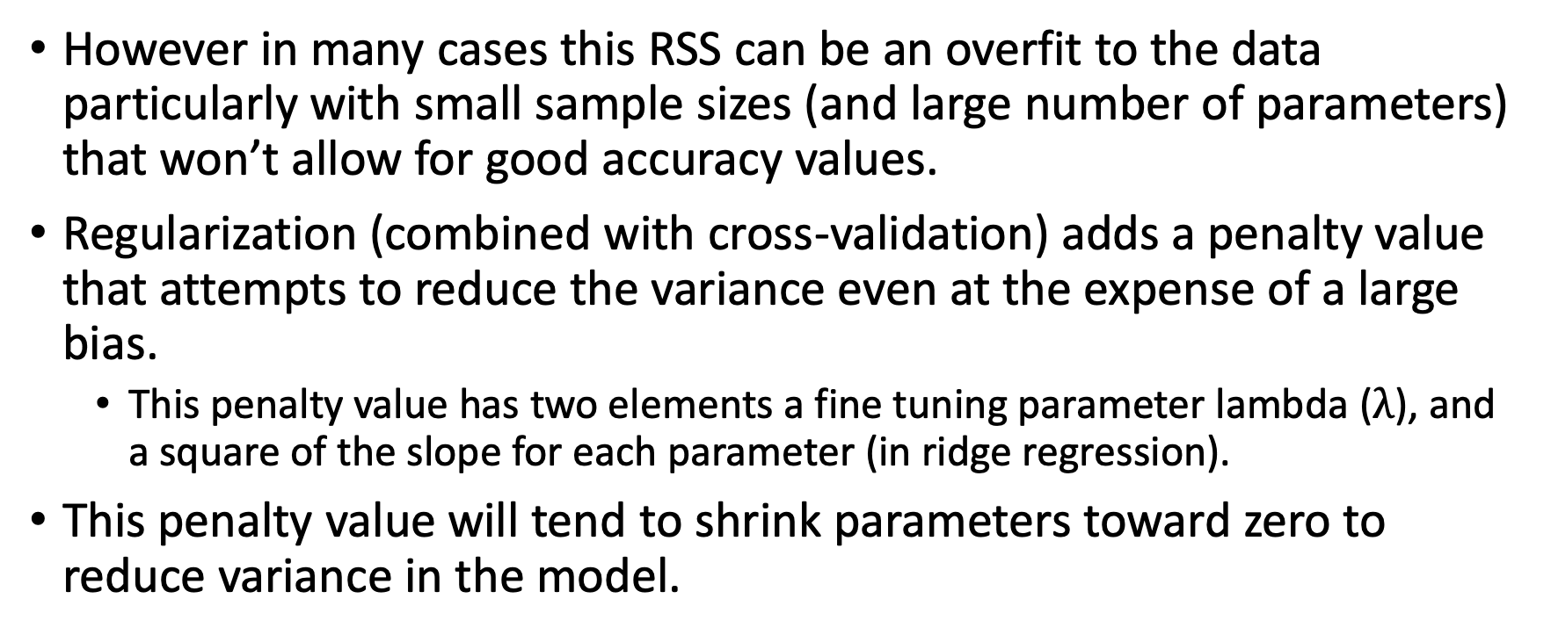
Regularization
However in many cases this RSS can be an overfit to the data particularly with small sample sizes (and large number of parameters) that won’t allow for good accuracy values.
Regularization (combined with cross-validation) adds a penalty value that attempts to reduce the variance even at the expense of a large bias.
This penalty value has two elements a fine tuning parameter lambda ($λ$), and a square of the slope for each parameter (in ridge regression).
This penalty value will tend to shrink parameters toward zero to reduce variance in the model.

Slide 6
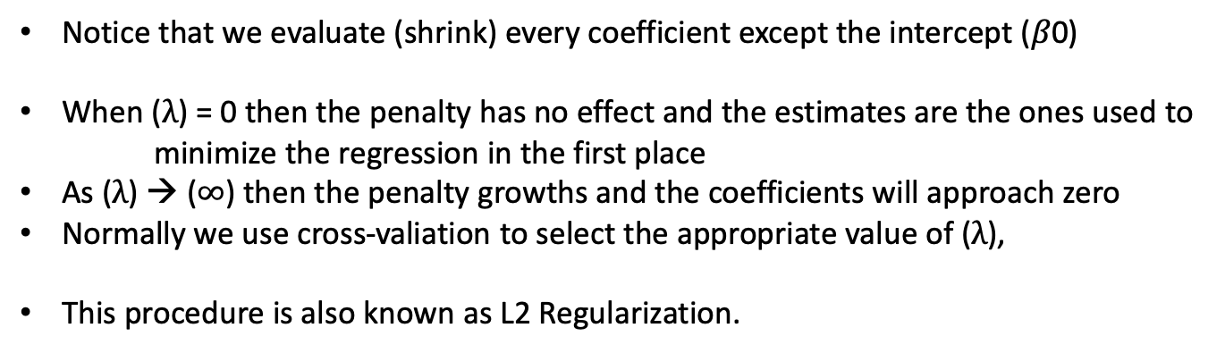
Ridge Regression
Notice that we evaluate (shrink) every coefficient except the intercept ($β$0)
When ($λ$) = 0 then the penalty has no effect and the estimates are the ones used to
minimize the regression in the first place
As ($λ$) → ($∞$) then the penalty growths and the coefficients will approach zero
Normally we use cross-valiation to select the appropriate value of ($λ$),
This procedure is also known as L2 Regularization.

Slide 7
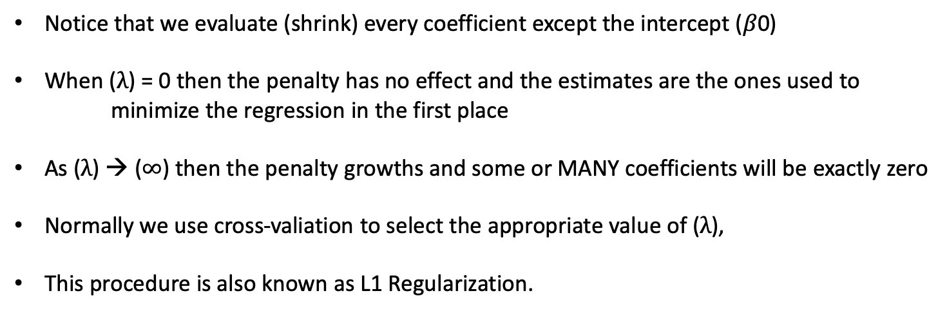
Lasso Regression
Notice that we evaluate (shrink) every coefficient except the intercept ($β$0)
When ($λ$) = 0 then the penalty has no effect and the estimates are the ones used to
minimize the regression in the first place
As ($λ$) → ($∞$) then the penalty growths and some or MANY coefficients will be exactly zero
Normally we use cross-valiation to select the appropriate value of ($λ$),
This procedure is also known as L1 Regularization.

Slide 8
Lasso Vs Ridge regression
Lasso is easier to interpret as some of the
Coefficients (the ones that have less
Importance) will be zero. In contrast,
in ridge regression no coefficient will reach
zero but some will approach zero.
The above image shows the constraint functions(green areas), for lasso(left) and ridge regression(right), along with contours for RSS(red ellipse). Credit : An Introduction to Statistical Learning by Gareth James, Daniela Witten, Trevor Hastie, Robert Tibshirani (https://towardsdatascience.com/regularization-in-machine-learning-76441ddcf99a)

Slide 9
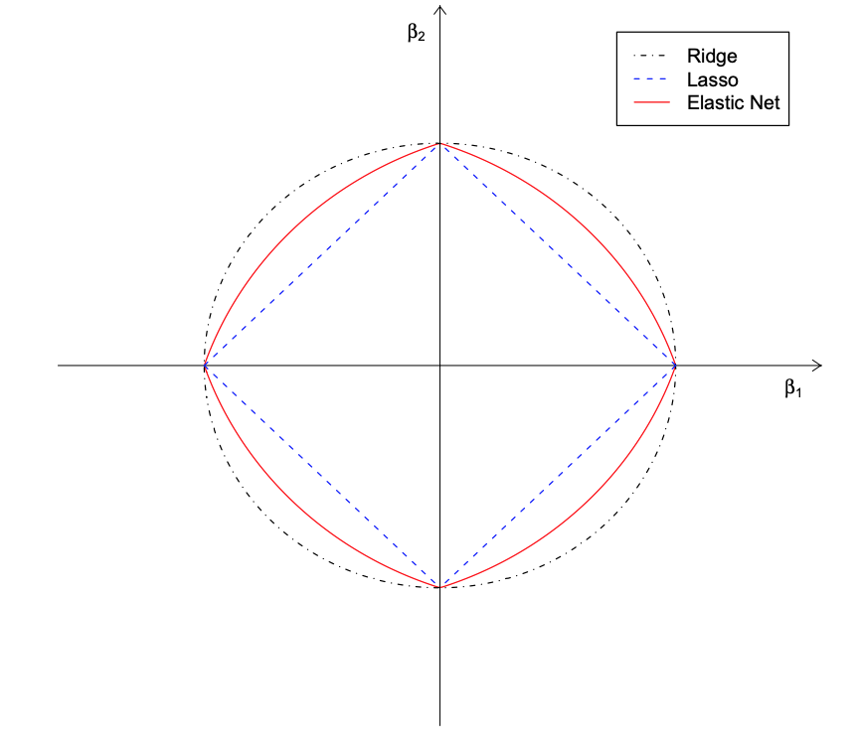
There are other ways to regularize a model
Elastic Net
The elastic net combines an L1 regulatization that allows coefficients to be zero, and a cuadratic element that allows as many variables as necessary to be shrunk.

Slide 10
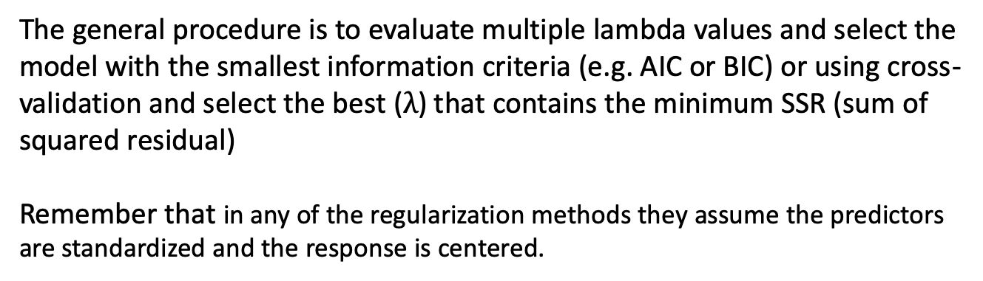
How to select the best model
The general procedure is to evaluate multiple lambda values and select the model with the smallest information criteria (e.g. AIC or BIC) or using cross-validation and select the best ($λ$) that contains the minimum SSR (sum of squared residual)
Remember that in any of the regularization methods they assume the predictors are standardized and the response is centered.

Slide 11
Next we will see an example of regularization in R.
These are some resources with good explanations about regularization
https://www.youtube.com/watch?v=Q81RR3yKn30
https://www.youtube.com/watch?v=NGf0voTMlcs
https://www.youtube.com/watch?v=1dKRdX9bfIo
https://www.youtube.com/watch?v=ctmNq7FgbvI
https://www.datacamp.com/community/tutorials/tutorial-ridge-lasso-elastic-net
https://hackernoon.com/an-introduction-to-ridge-lasso-and-elastic-net-regression-cca60b4b934f
https://web.stanford.edu/~hastie/TALKS/enet_talk.pdf

